Slide 1
Spain Auto Direct Machine Learning Price Optimization Models
Jeffrey Molgano
1 February 2019

Slide 2
Agenda Project Context Models Modeling Process Results Implementation

Slide 3
Project Context | Business
WEM
Spain
Pricing
Auto
Direct
*

Slide 4
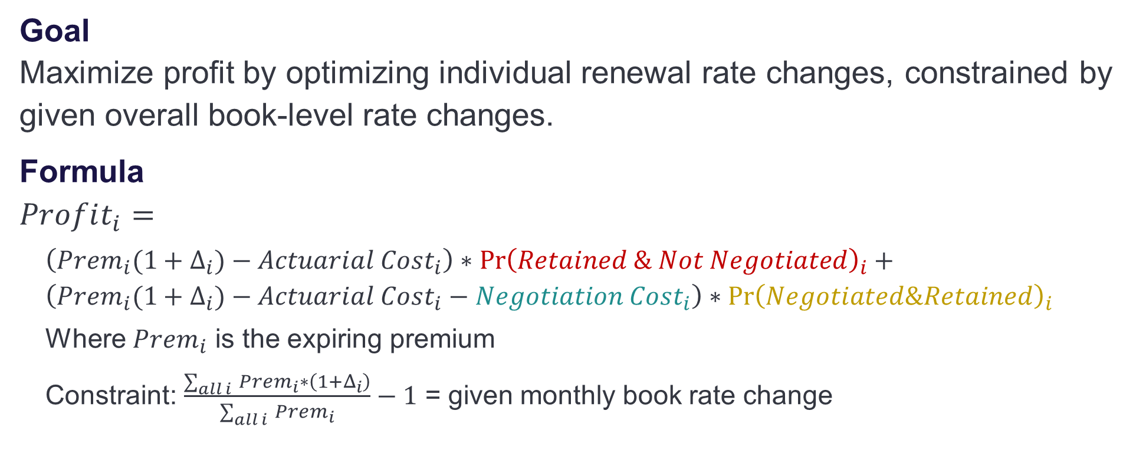
Project Context | Price Optimization
Goal Maximize profit by optimizing individual renewal rate changes, constrained by given overall book-level rate changes.
Formula $Profit_{i}=$
$\left(Prem_{i}(1+Δ_{i})−Actuarial Cost_{i}\right)∗\operatorname{Pr}{{\left(Retained \& Not Negotiated\right)}_{i}}+$ $\left(Prem_{i}({1+Δ}_{i})−Actuarial Cost_{i}−Negotiation Cost_{i}\right)∗{\operatorname{Pr}\left(Negotiated\&Retained\right)}_{i}$
Where $Prem_{i}$ is the expiring premium
Constraint: $\frac{\sum_{all i }{Prem_{i}∗\left(1+Δ_{i}\right)}}{\sum_{all i }{Prem_{i}}}−1$ = given monthly book rate change

Slide 5
Agenda Project Context Models Modeling Process Results Implementation

Slide 6
Models | Overview
Model Name | Prediction | Target | # Obs.* | Response*
Cancellation Terceros^ | Likelihood of cancellation for non-comprehensive policies | Binary | 145,535 | 36.54%
Cancellation Todo Riesgo^ | Likelihood of cancellation for comprehensive policies | Binary | 116,873 | 35.41%
Negotiation Probability^ | Likelihood of negotiation for renewed policies (both comp and non-comp) | Binary | 262,408 | 25.49%
Negotiation Amount | Amount of negotiated discount (both comp and non-comp) | Continuous | 66,892 | EUR 49.83
Cancellation models count a negotiation as a “cancellation” ^
Negotiation probability model assumes a negotiated policy is renewed ^
For the Train/Validate combined dataset *

Slide 7
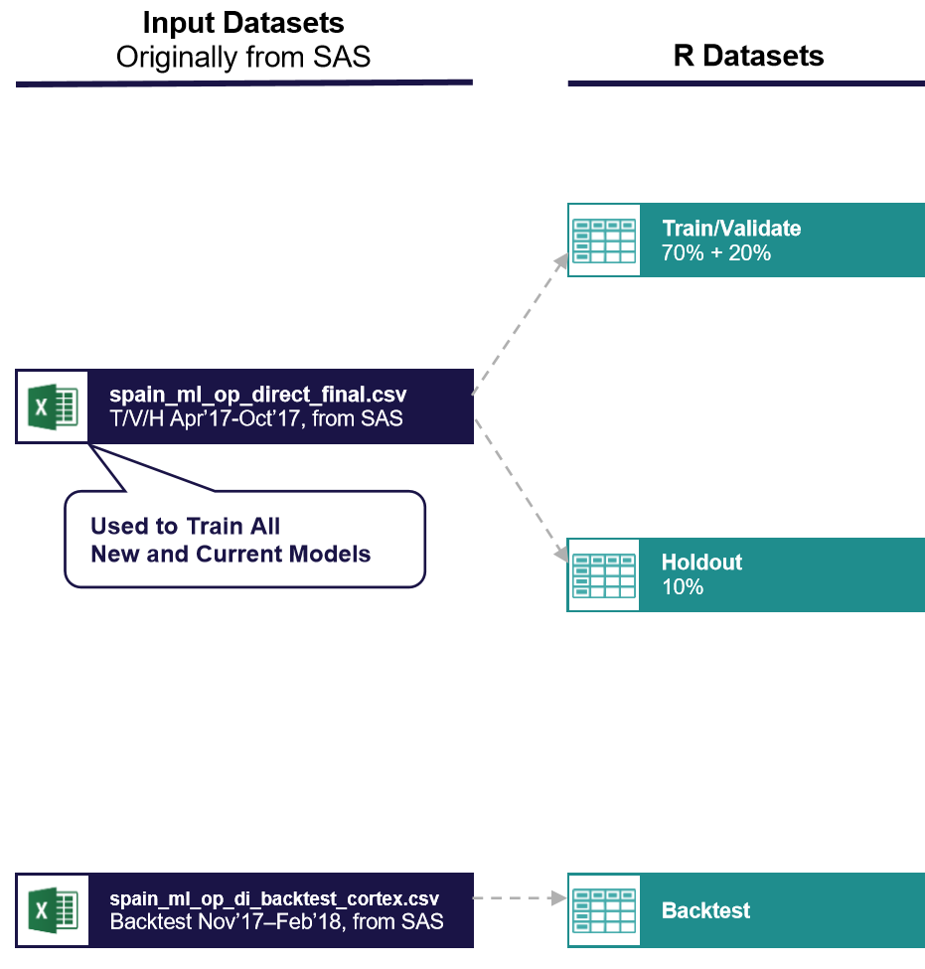
Models | Data and Variables
Explanatory Variables: 621
Continuous: 565 (including binary)
Factor: 56
Variables removed due to future information leak
“Presupuesto” (inquiry) variables: Due to database deletion procedure, when a policy cancelled, all record of prior inquiries were deleted. Thus there was future information leak because cancelled policies had 0 inquiries which the model rapidly detected as predictive
_M2, _M4, MAD variables: These are variables evaluated as of 2 or 4 months in the future, past the renewal date
Historical accumulated accepted rate change: Includes the rate accepted for the renewal in question in addition to past accepted rates, thus includes future information
Convert variables: Same problem as the presupuesto variables where database erasure means there’s future information leak
Overfitting
Covariate Shift

Slide 8
Agenda Project Context Models Modeling Process Results Implementation

Slide 9
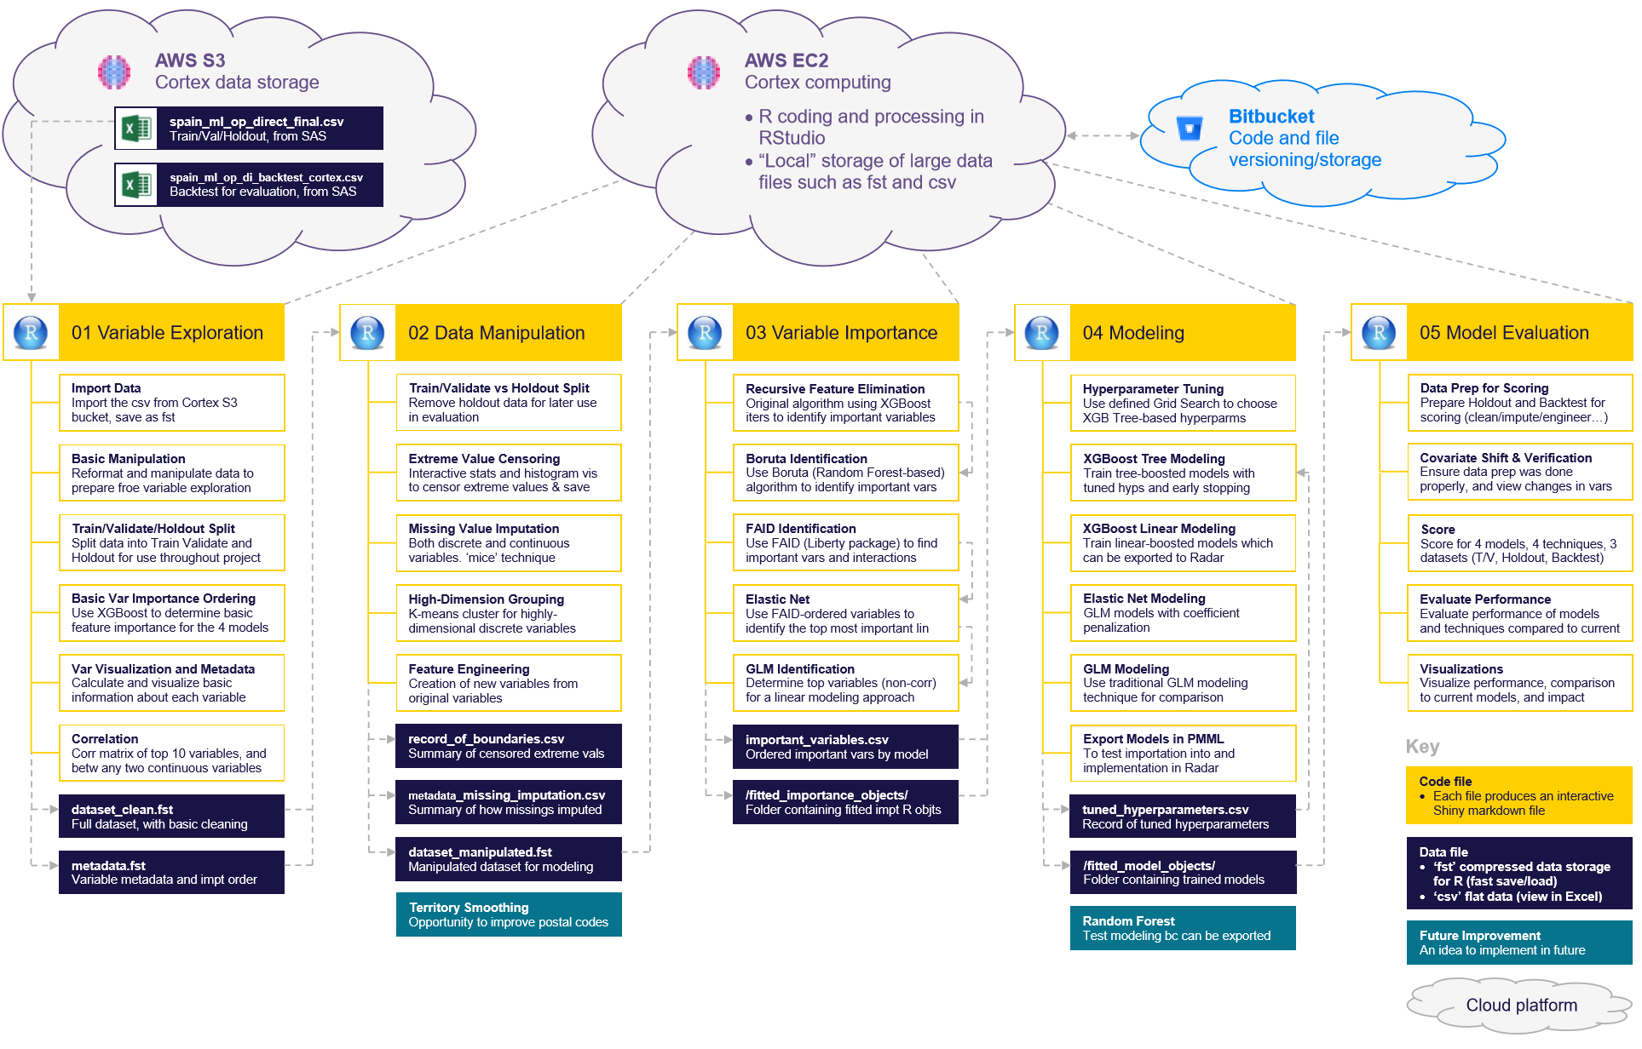

Slide 10
01 Variable Exploration | Overview
Import Data & Basic Manipulation
Train/Validate/Holdout Split
Basic Variable Importance Ordering Use XGBoost to order the variables by basic importance for each of the 4 models. This is to help decrease the number of variables upon which to focus
Variable Visualization and Metadata Visualize the most important variable’s distribution and target response, as well as their basic metadata
Correlation Visually and numerically understand if any top features are correlated

Slide 11
02 Data Manipulation | Overview
Train/Validate vs Holdout Split Completely remove the identified holdout group from the dataset so it can be used for unbiased data evaluation later on
Extreme Value Censoring Choose min/max for continuous variables with extreme values based on histograms and calculated cutoffs
Missing Value Imputation Impute missing values for the linear models which require it
High-Dimension Grouping Group factor (discrete) variables with many levels using K-means clustering
Feature Engineering Create new calculated features from variables already in the dataset (ex. EUR premium change, difference of rate to average historical rate)

Slide 12
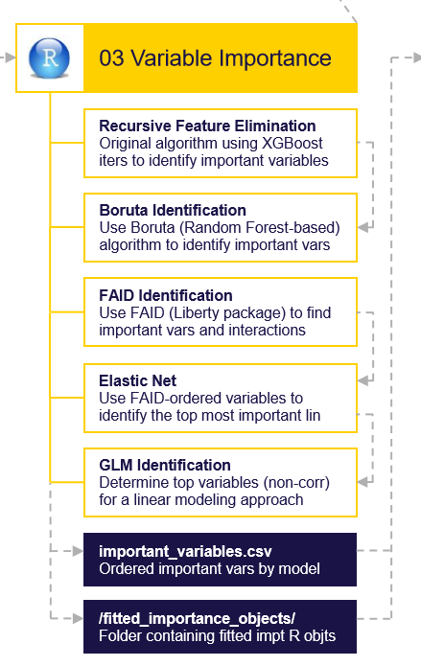
03 Variable Importance | Overview
Non-Linear Variable Importance
Recursive Feature Elimination (Non-Linear) Original algorithm using tree-based XGBoost models to recursively remove features
Boruta Identification (Non-Linear) Check the above selected features with this random forest wrapper method which eliminates unimportant variables by comparing them to shuffled “shadow” variable performance
Linear Variable Importance
FAID (Linear) Liberty created library for detecting linear interactions, and variable importance ordering (linear and non-linear models). Use it to order important linear variables and identify interactions
Elastic Net (Linear) Use FAID fillin ordered variables in this GLM with penalization (Lasso or Ridge penalization), where the lambda parameter is determined with cross-validation
GLM Identification (Linear) Use Elastic Net identified variables, and remove those which are multicollinear using recursive Variance Inflation Factor (VIF) algorithm

Slide 13
04 Modeling | Overview
Hyperparameter Tuning Use Grid Search with selected combinations to tune XGBoost Tree based parameters, balancing stability and accuracy
XGBoost Tree-Based Modeling Train XGBoost using a tree booster and early stopping with the above tuned hyperparameters
XGBoost Linear-Based Modeling Train XGBoost using a linear booster using early stopping
Elastic Net Modeling Train an Elastic Net
GLM Modeling Train a GLM
Model Exportation to PMML Incomplete – will test exporting the trained models as pmml (predictive model markup language) for use in Radar Optimizer

Slide 14
04 Modeling | How XGBoost Works
XGBoost = eXtreme Gradient Boosting Machine
eXtreme: Faster and more accurate (than GBM)
Gradient: Uses a gradient descent algorithm to minimize the loss (error) when creating new trees
Boosting: Ensemble technique where each sequential decision tree tries to reduce the errors from the prior tree (as opposed to a bagging ensemble technique which averages independent trees’ predictions)

Slide 15
05 Model Evaluation | Overview
Data Prep for Scoring Prepare the Holdout and Backtest datasets for scoring by applying all of the manipulations from Steps 01 and 02 (cleaning, extreme values, missing imputation, engineering, grouping)
Covariate Shift Detection Identify top variable shifts between datasets by seeing if a model can accurately identify if an observations comes from Train/Validate or the Holdout or Backtest
Data Prep Verification Verify that the data prep correctly prepared the data for scoring
Evaluate Model Performance Use trained models to score the prepared datasets, and calculate evaluation metrics from them
Visualizations Visualize performance, comparisons to current models, and impacts of the new models

Slide 16
Agenda Project Context Models Modeling Process Results Implementation

Slide 17
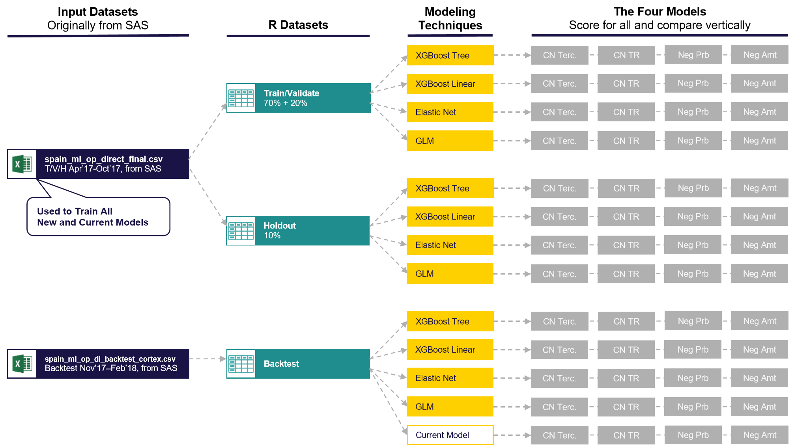

Slide 18
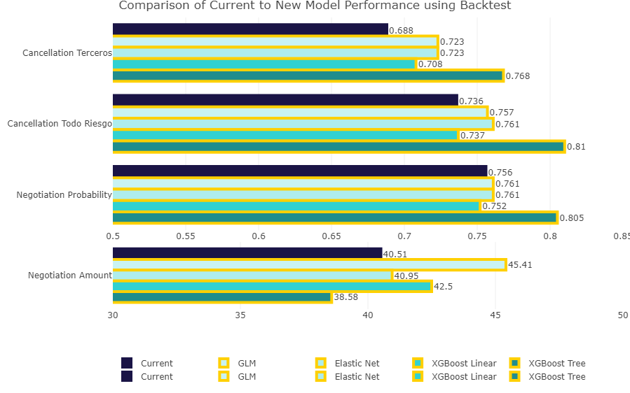
Results | Backtest Comparison
Reasons for Improvements
Advanced sequential tree-based learning
New engineered variables
More original variables used
More interactions used

Slide 19
Results | Modeling Technique Comparisons
Training & Feature Selection Difficulty
Hard
Easy
Scoring Difficulty
Hard
Easy
Predictiveness
Low
High
Interpretability
Hard
Easy
XGBoost Tree
XGBoost Linear
Elastic Net
GLM

Slide 20
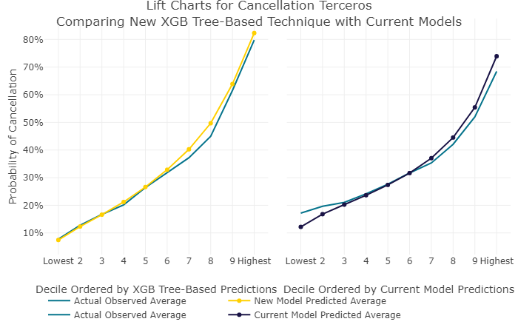
Results | CN Terceros Lift Charts

Slide 21
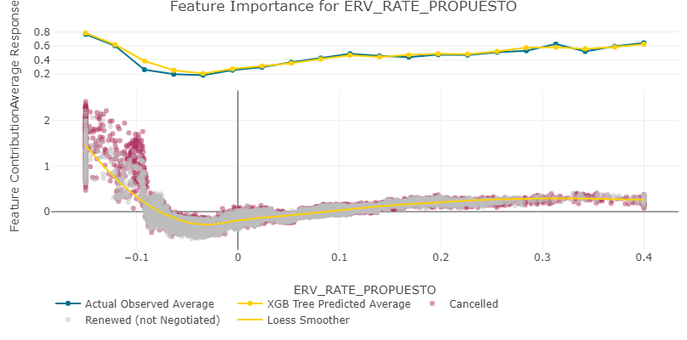
Results | CN Terceros Rate Impact

Slide 22
Agenda Project Context Models Modeling Process Results Implementation

Slide 23
Implementation | Next Steps
Investigate options for XGBoost tree-based modeling to force monotonic behavior (larger discount, force model to predict lower chance of cancellation)
Visualization of Rate Change feature contribution
Test with Random Forest
Test exportation to PMML for use in Radar Optimizer
Estimate € impact of improved accuracy (either with calculations or A/B[/C] testing)
Apply modeling process to other channel (brokers or a partner)

